Slide 1
OOP in JavaScript

Slide 2

Functions
What?
A value of type “function”
Can be used as a value:
const sayHello = function () { console.log(‘Hello, world’); }
A subprogram designed to perform a particular task
parseInt(2.5); isNaN(‘2’); alert(‘Hello, world’);
executed when they are called (function invoking)

Slide 3
Functions
Why?
Code reuse - D.R.Y
OOP
Modularize
And more…!

Slide 4
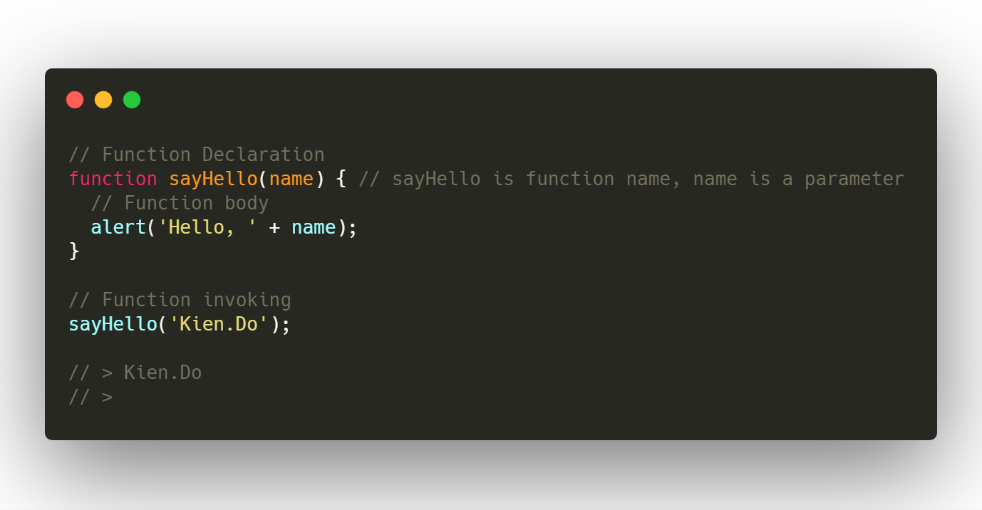
Functions
How?

Slide 5
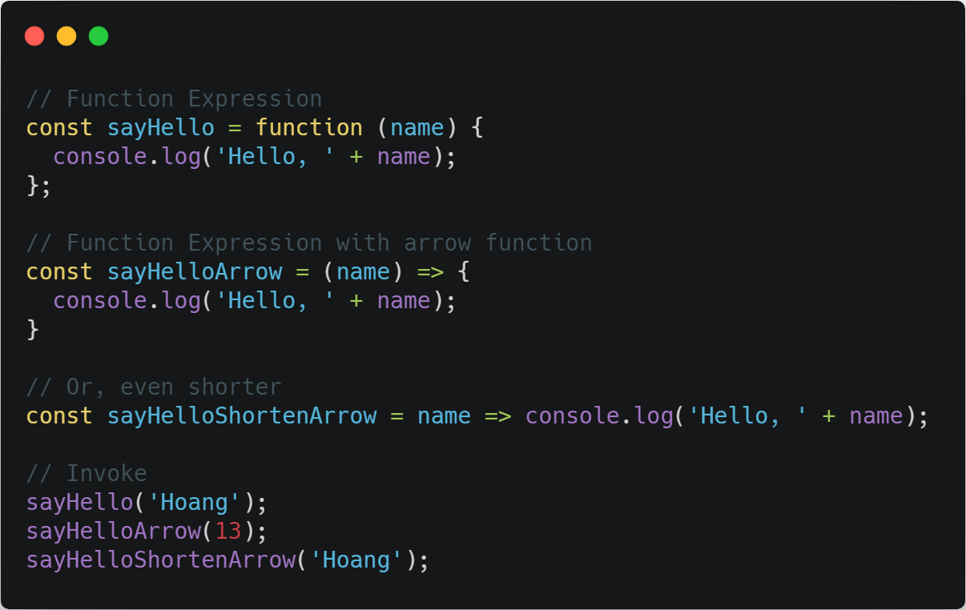

Slide 6
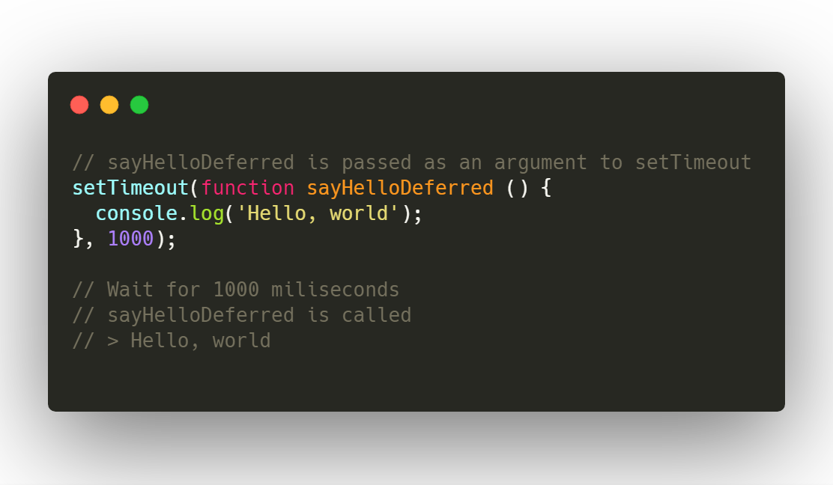
Callback function
A function, passed to another function as an argument
Can be called inside that other function

Slide 7
OOP Definitions
Class - a template - Dog
Method - A defined capability of a class - bark()
Attribute - A defined data item in a class - color
Object or Instance - A particular instance of a class - Lassie

Slide 8
Class
Defines the abstract characteristics of a thing (object), including the
thing's characteristics (its attributes, fields, or properties) and the thing’s behaviors (the things it can do, or methods, operations, or features).
A class is a blueprint or factory that describes the nature of something. For example, the class Dog would consist of traits shared by all dogs, such as breed and fur color (characteristics), and the ability to bark and sit (behaviors).

Slide 9
Class
A pattern (exemplar) of a class. The class of Dog defines all possible dogs by listing the characteristics and behaviors they can have; the object Lassie is one particular dog, with particular versions of the characteristics. A Dog has fur; Lassie has brown-and-white fur.

Slide 10
Instance/Object
One can have an instance of a class or a particular object. The instance is the actual object created at runtime. In programmer jargon, the Lassie object is an instance of the Dog class. The set of values of the attributes of a particular object is called its state. The object consists of state and the behavior that’s defined in the object’s class.

Slide 11
Method
An object’s abilities. In language, methods are verbs. Lassie, being a Dog, has the ability to bark. So bark() is one of Lassie’s methods. She may have other methods as well, for example sit() or eat() or walk() or save_timmy(). Within the program, using a method usually affects only one particular object; all Dogs can bark, but you need only one particular dog to do the barking

Slide 12
Objects in JavaScript
The OO pattern in JavaScript is a little different.
The function is indeed a store and reuse pattern.
The function keyword returns a value which is the function itself - it makes a function!

Slide 13
First-Class Functions
In computer science, a programming language is said to have first-class functions if it treats functions as first-class citizens. Specifically, this means the language supports passing functions as arguments to other functions, returning them as the values from other functions, and assigning them to variables or storing them in data structures.

Slide 14
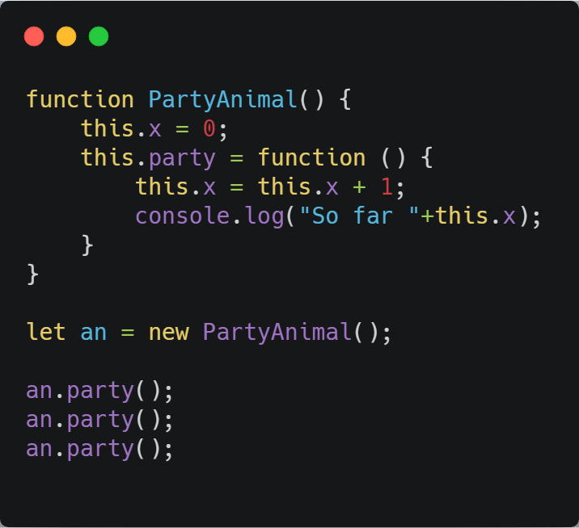
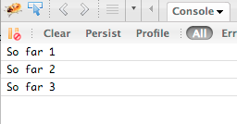
Sample
This is the template for making PartyAnimal objects.
Each PartyAnimal object has a bit of data.
Each PartyAnimal object has a bit of code.
Create a PartyAnimal object
Tell the object to run the party() code.

Slide 15
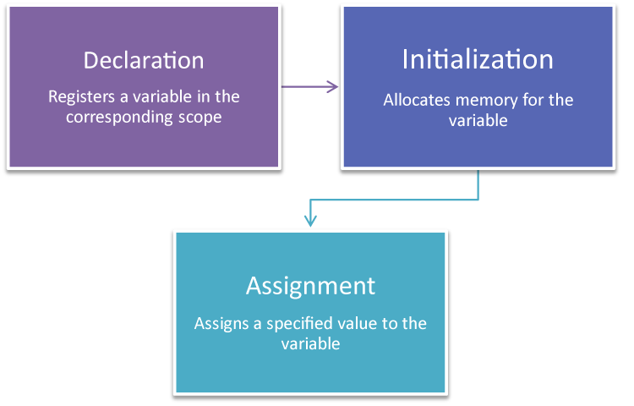
Variables Life Cycle

Slide 16
Object Life Cycle
Objects are created, used, and discarded - Just like a variable
Constructors are implicit in JavaScript - natural
A constructor in a class is a special block of statements called when an object is created
Destructors are not provided by JavaScript

Slide 17
Many Instances
We can create lots of objects - the class is the template for the object.
We can store each distinct object in its own variable.
We call this having multiple instances of the same class.
Each instance has its own copy of the instance variables.

Slide 18
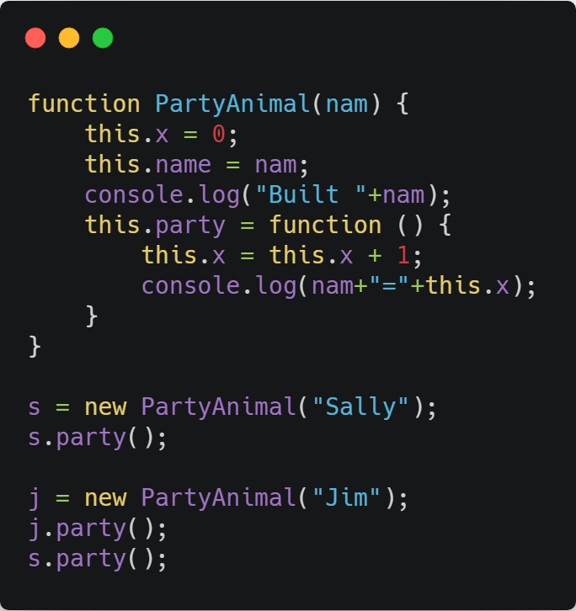
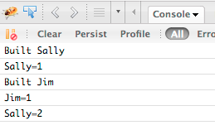
Many Instances
Constructors can have additional parameters. These can be used to set up instance variables for the particular instance of the class (i.e., for the particular object).

